Slide 1


Vehicle Re identification in Deep Learning domain: Computer Vision
Student name: Lava Kumar Saripudi

Slide 2

TABLE OF CONTENTS
1.Vehicle re identification in deep learning
2.Literarture Review
3.Application of vehicle re identification in current research
4. Potential Future Developments

Slide 3

Vehicle re identification in deep learning
Re-identifying vehicle is a crucial computer vision problem that seeks to recognize and track vehicles across various cameras or video frames. In this area, deep learning models have shown findings that are encouraging, offering precise and effective solutions.
Example - automatic license plate recognition (ALPR), AutoVu™ solution
Deep learning techniques for vehicle re-identification have great promise for several sectors, including surveillance and security, transportation administration, the auto industry, and urban planning.
Scope:
The goal of the project is to create methods that can successfully match and identify automobiles in a variety of camera angles, lighting situations, occlusions, and image alterations.

Slide 4
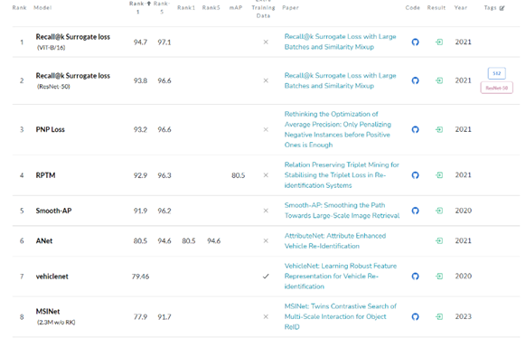
State-Of-the-Art Techniques list in Vehicle Re identification:

Slide 5


Literature Review
There are many approaches that address various challenges such as occlusions, viewpoint variations, and complex backgrounds in vehicle re identification.
Some of them include the combination of appearance and motion information, the use of Transformer-based architectures, the incorporation of co-segmentation information, and the orientation-aware approach.

Slide 6
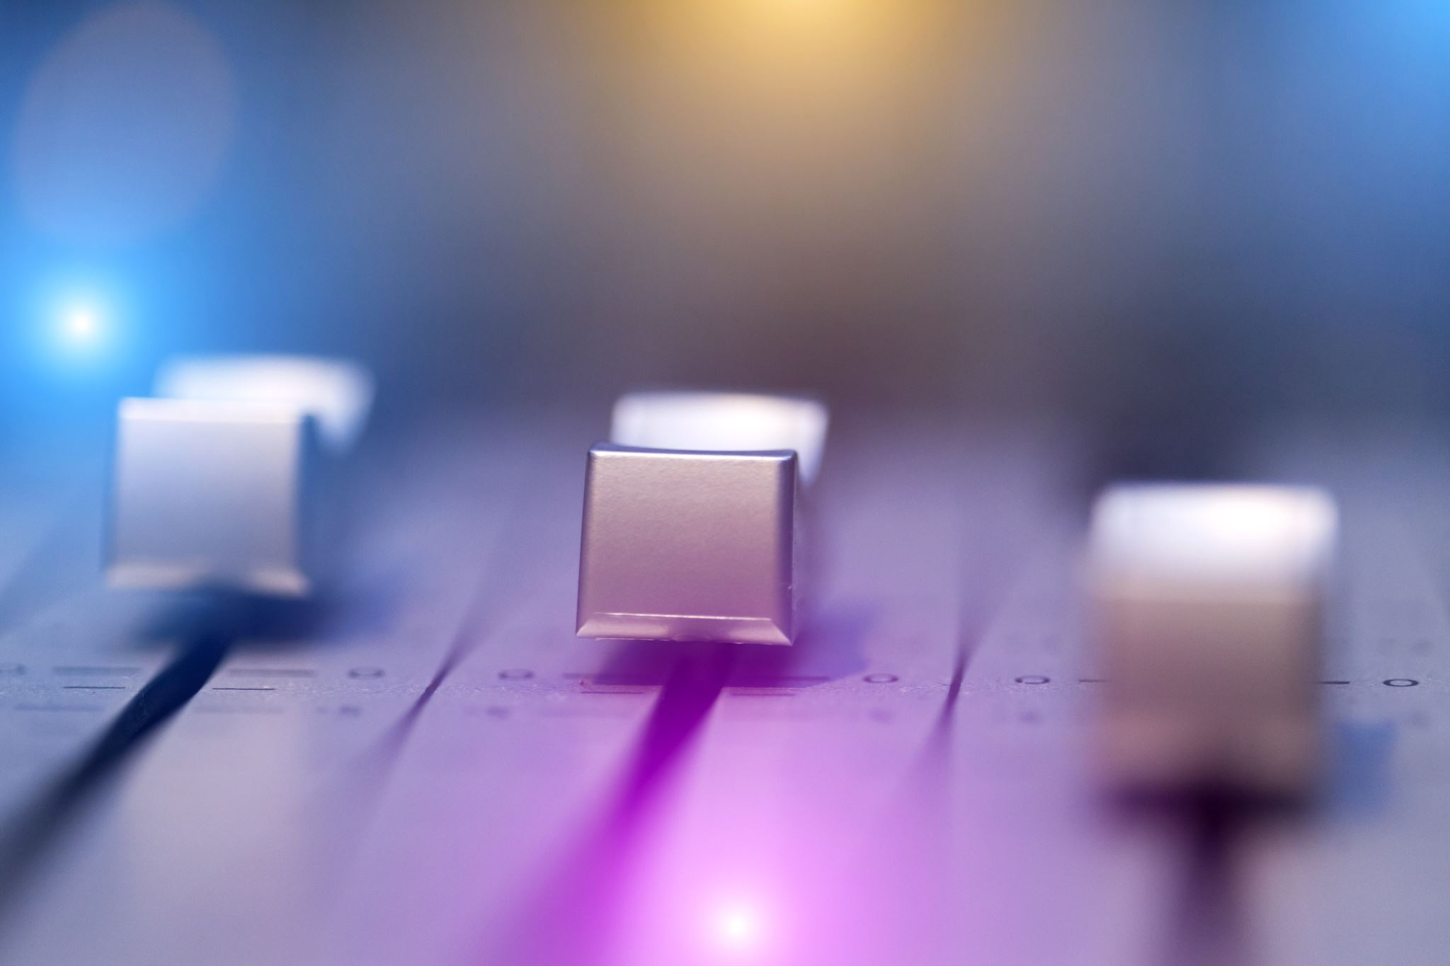
TECHNIQUES
1. A Two-Stream Siamese Neural Network
2. TransReID: Transformer-based Object Re-Identification
3. VOC-ReID: Vehicle Re-identification based on Vehicle-Orientation-Camera
4. Orientation-aware Vehicle Re-identification with Semantics-guided Part Attention Network

Slide 7
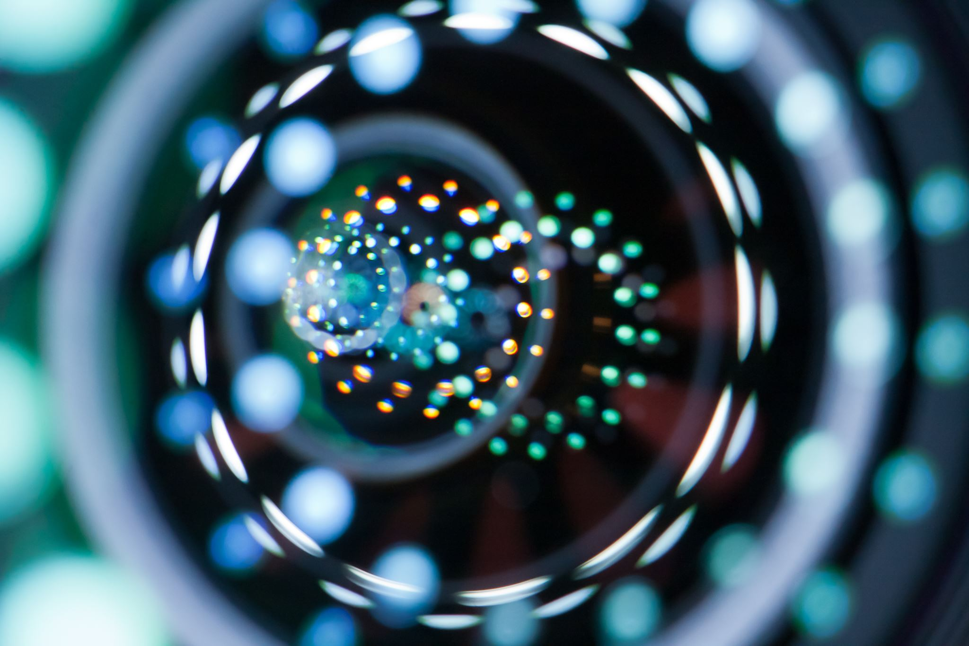
HIGHLIGHTS
Two-stream architecture captures appearance and spatial features effectively and achieves high accuracy in vehicle re-identification with Robust feature representation and accurate matching
TransReID applies transformer-based models for object re-identification. It captures long-range dependencies and complex relationships. It achieves state-of-the-art performance in vehicle re-identification.
VOC-ReID utilizes vehicle-object co-segmentation for improved feature representation. It Handles partial occlusions and background clutter effectively and enhances feature representation and matching accuracy.
Orientation-Aware considers vehicle orientation information for better matching and improves matching performance in challenging scenarios. It Provides enhanced accuracy and robustness in orientation variations

Slide 8

LIMITATIONS
The limited investigation of more complex approaches, such as multi-scale features or attention mechanisms. Limited datasets and relatively smaller-scale tests and evaluations may hinder generalizability.
The lack of thorough evaluation and comparison with other cutting-edge techniques in the vehicle re-identification field. Limited investigation of architectural modifications or vehicle-specific enhancements.
Due to the co-segmentation component, computational complexity is relatively higher. Only a limited number of real-time applications and larger datasets have been explored.
Limited comparison with cutting-edge techniques and evaluation on large-scale datasets. Possible difficulties in generalizing to many real-world settings and variations.

Slide 9
APPLICATIONS OF VEHICLE RE IDENTIFICATION IN CURRENT RESEARCH
Healthcare: In Identifying and tracking ambulance vehicles with the use of vehicle re-identification can lead to better ambulance dispatch and routing during crises. It makes it possible for quicker reaction times and more efficient resource management.
Finance: Tracking and monitoring the movement of high-value assets, such as automobiles used in banking or logistics operations, can be done through vehicle re-identification. Real-time visibility is provided, allowing for efficient asset management and security.
Retail and Marketing Analytics: Re-identification of vehicles can offer insightful data for retail and marketing analytics. Businesses can track consumer activity, gauge foot traffic, examine client demographics, and adjust marketing techniques by detecting cars.
Transportation: Essential for intelligent parking, traffic monitoring, and other smart transportation systems. These technologies can streamline traffic flow, boost security, and boost overall transportation effectiveness by precisely tracking and recognizing cars.
Automated Tolling and Access Control: Automated tolling systems use vehicle re-identification so that vehicles can be precisely identified for quick and easy toll collecting. Additionally, it is used in access control systems, enabling approved cars to enter places that are off-limits.

Slide 10
POTENTIAL FUTURE DEVELOPMENTS
Privacy-Preserving Techniques: The privacy of people and their automobiles can be safeguarded via the development of privacy-preserving techniques, such as secure and encrypted feature extraction or differential privacy measures.
Advanced Deep Learning Models: To enhance feature representation and matching accuracy, this includes investigating novel designs like attention mechanisms, graph convolutional networks, or generative adversarial networks.
Robustness to Environmental Factors: A significant area for improvement is increasing the robustness of vehicle re-identification models to diverse environmental circumstances, including changes in weather, illumination, and viewpoint shifts. These difficulties can be overcome with the aid of methods like adversarial training, data augmentation, and domain adaptability.

Slide 11
CHALLENGES
Variability in Environmental Conditions: Vehicle re-identification systems may encounter difficulties while adjusting to changes in ambient factors including lighting, weather, and occlusions
Limited Viewpoints and Camera Coverage: Systems for re-identifying vehicles rely largely on camera coverage and having access to several viewpoints so that vehicles can be photographed from various angles. The efficiency of these systems may be constrained by limited camera coverage or restricted perspectives, particularly in densely populated areas or by extensive monitoring networks.
Privacy Concerns: Vehicle re-identification systems acquire and process personal data, which raises questions about privacy. It's vital to strike a balance between the necessity for precise identification and privacy protection
Computational Resources and Real-Time Constraints: For training and inference, deep learning models for vehicle re-identification frequently need a lot of computing power. The computational complexity of these models makes real-time implementation difficult.

Slide 12

POTENTIAL SOLUTIONS
Improved Feature Representation: Creating sophisticated feature representation methods can improve the models' ability to discriminate. To capture more accurate and reliable representations of cars, methods like attention mechanisms, graph convolutional networks, or self-supervised learning can be investigated.
Robustness to Environmental Variations: It is essential to create algorithms that are more resistant to environmental changes. Techniques for data augmentation that are intended to imitate various lighting and weather situations may be used in this.
Multi-Modal Fusion: The accuracy and robustness of vehicle re-identification can be increased by integrating numerous modalities, including photos, videos, and sensor data (such LiDAR, radar). To efficiently merge data from several modalities, fusion strategies like late fusion, early fusion, or attention-based fusion might be examined.
Privacy-Preserving Methods: To address privacy issues, privacy-preserving procedures must be developed. To preserve the effectiveness of the re-identification process while retaining the privacy and security of the data, strategies like federated learning, secure multi-party computation, or differential privacy can be investigated

Slide 13
REFERENCES
A Two-Stream Siamese Neural Network for Vehicle Re-Identification by Using Non-Overlapping Cameras - https://paperswithcode.com/paper/a-two-stream-siamese-neural-network-for
TransReID: Transformer-based Object Re-Identification: https://paperswithcode.com/paper/transreid-transformer-based-object-re
VOC-ReID: Vehicle Re-identification based on Vehicle-Orientation-Camera: https://paperswithcode.com/paper/voc-reid-vehicle-re-identification-based-on
Orientation-aware Vehicle Re-identification with Semantics-guided Part Attention Network: https://paperswithcode.com/paper/orientation-aware-vehicle-re-identification

Slide 14

THANK YOU

